Slide 1
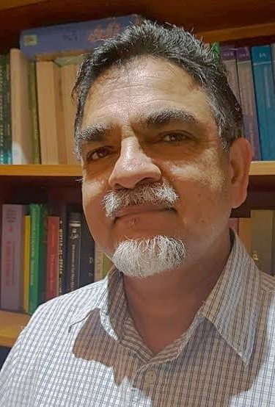
Continuity and Change: Islamic Education in South Africa
Sound on
Professor Yasien Mohamed (university of the western cape)

Slide 2
1. Historical Background
1658
Muslims arrived on the southern tip of Africa in 1658 from the Indonesian archipelago.
1807
Abdullah Kadi Abdus Salaam (d. 1807), known as Tuan Guru. First Islamic school (madrasa)
1860
In 1860 Shaykh Abu Bakr Effendi (d. 1880) a Turkish scholar who had come to the Cape. School of Higher Islamic Education.
1955
Since 1955 departments of Arabic and Islamic studies South Africa.

Slide 3
2. Community-inspired Higher Education:
The Newcastle Islamic Seminary (Darul Ulum)
In 1971: Newcastle seminary, Kwazulu Natal.
Darsi Nizami
Aim: preserve the Islamic faith
Subjects: Qur’an, Prophetic Traditions (Hadith), and the Hanafi legal school.
Method: Memorization and transmission. Not critical thinking.

Slide 4
The Islamic College of Southern Africa (ICOSA)
In 1990 the Islamic College of Southern Africa (ICOSA) was established in Gatesville, Cape Town.
Combine: Traditional and Modern.

Slide 5
3. Three Tertiary Islamic Institutions in Democratic South Africa
The three tertiary Islamic institutions emerged in Democratic South Africa after 1994.
Core Islamic subjects
Respond to modernity

Slide 6
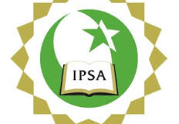
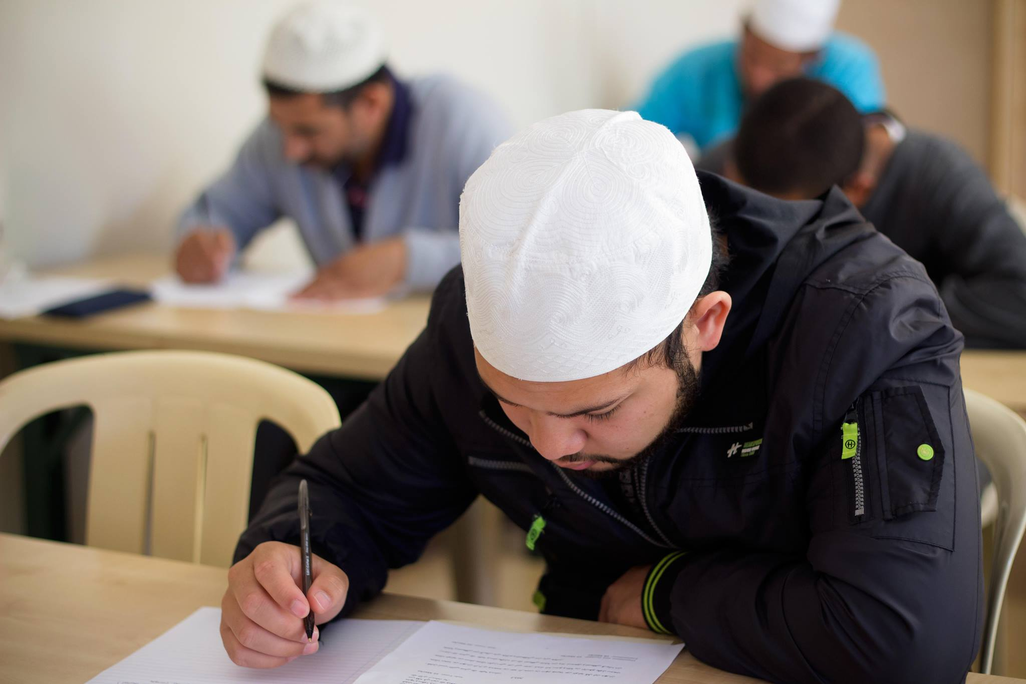
The International Peace College of Southern Africa (IPSA)
(IPSA) was established 2005.
One year certificate: School leavers
Bachelor: Bachelor of Arts in Islamic Studies
Honours: 2016: Maqasid al-Shariah.
2020: Masters
Dr Jasser, the chair of the Maqasid Programme: diversity of students from the traditional and professional backgrounds contributed to the fruitful debates and discussions in the classroom.
Aim: Combine Islamic and western; Objectives of Islamic law (maqasid al-shariah)
Compulsory: Contemporary Islamic Thought, research methodology and a research paper.
Research focus-research paper, 10 000, applied maqasid.
Pedagogy: critical reflection, practical application and problem solving activities.
Relevance to the contemporary world.

Slide 7
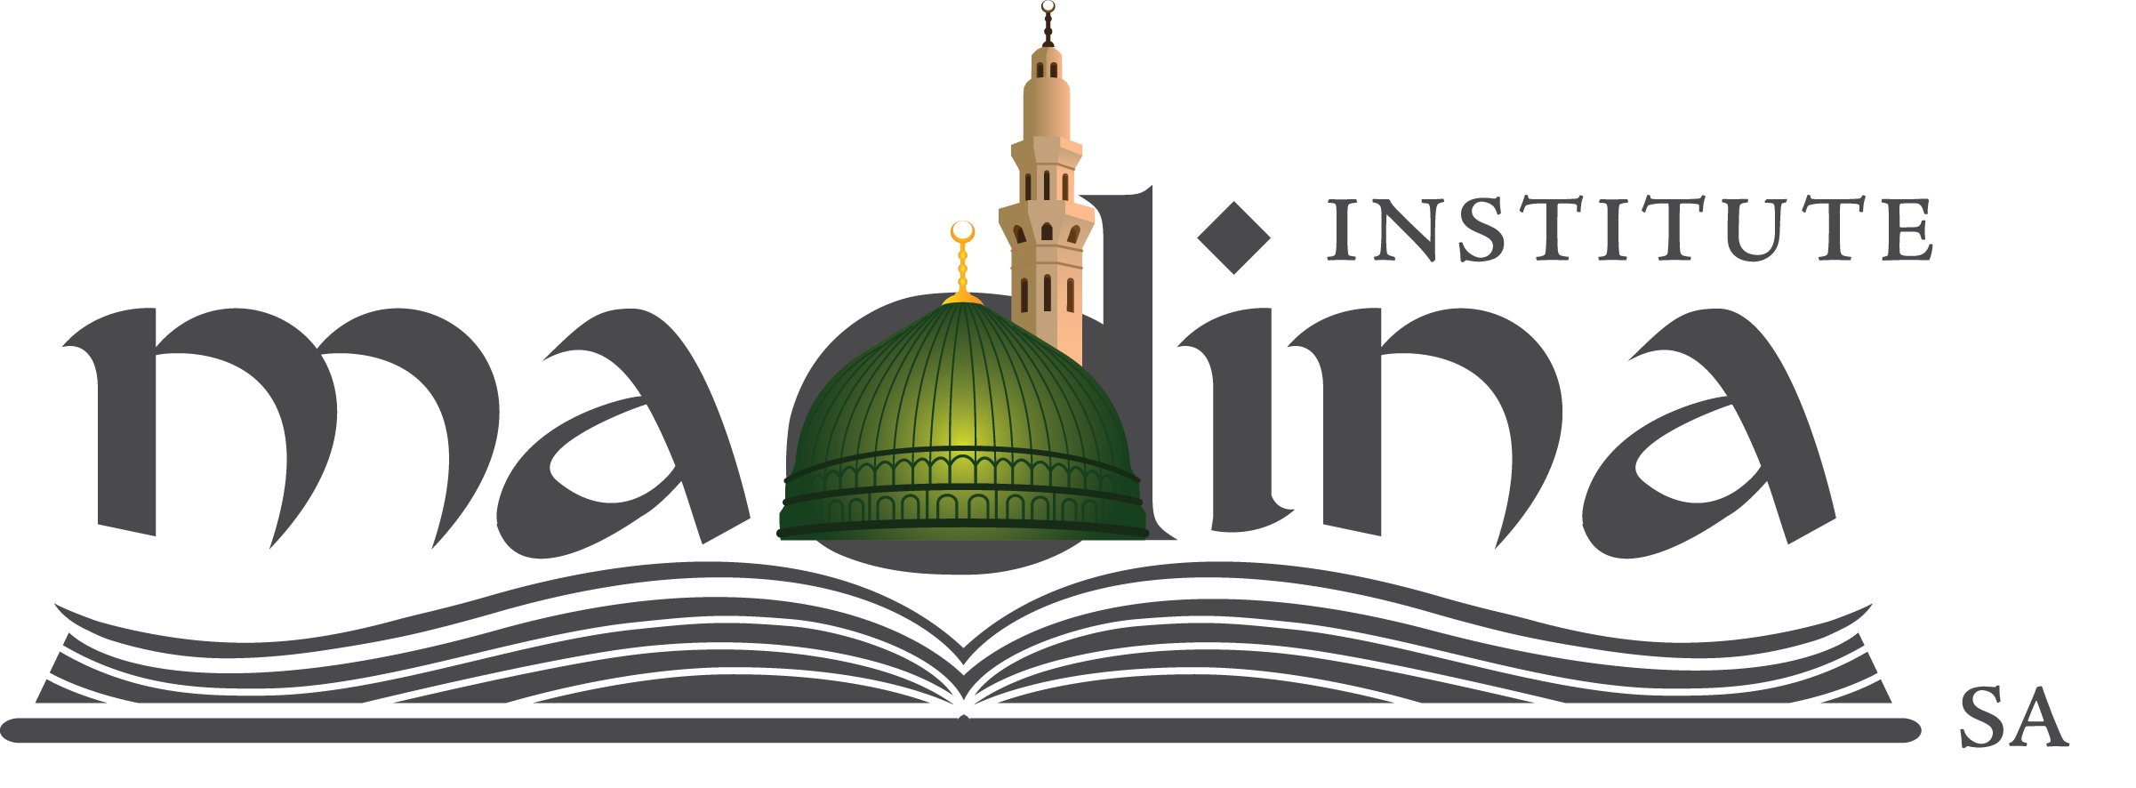
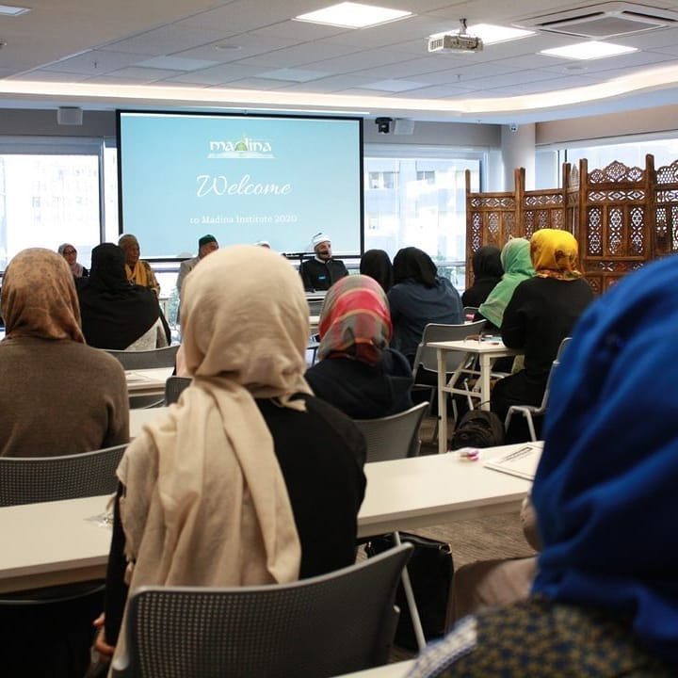
Madina Institute, Cape Town
2014, one-year intensive Usul al-Din Program, which combines the study of Arabic and Islamic studies.
Traditional with modern setting. International students were also attracted to the programme, and they came from North America, South America and Germany.
The Sufi Shaykh Yahya al-Ninowy, the founder of the Institute, is trained in Hadith studies, Medicine, and Sufism.
Open-minded and tolerant approach: various schools of thought.
German students: Come for spiritual and traditional
Three-year Bachelor of Arts in Islamic studies, (Usul al-Din). Although the content taught is traditional, but modern
Culture of compassion and tolerance
Accredited institution.

Slide 8
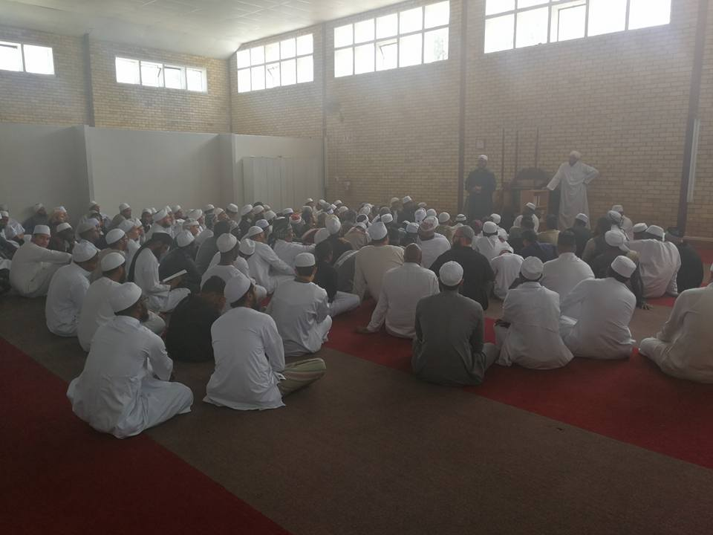
Dar al-Ulum al-Arabiyyah al-Islamiyyah (The Strand Seminary)
Established in 1996, and founded by Moulana Taha Kieraan, a traditionally trained graduate from Deoband Darul Ulum.
Moulana Kieraan: No formal Western qualifications, but well-read:
Graduates should face the challenges of modern world.
The seminary attracts international students.
It offers a 2-year introductory course followed by a 4-year ʿĀlimiyyah course:
The introductory course offers the following disciplines: ʿAqīdah (Islamic Creed), Uṣūl al-Fiqh (Legal Theory), Fiqh (Islamic Law), Ḥadīth (Prophetic Narrations) and its critical sciences, ʿUlūm al-Qurʾān (Sciences of the Qurʾān), Tafsīr (Qurʾānic Exegesis), Tazkiyah (Islamic Spirituality) and Sīrah (Prophetic Biography).

Slide 9
The pedagogy: 4-6th year: more depth. Arabic text with comprehension.
small classes, intimate teacher-student interaction
Encourage reading, build own library.
No research paper: But independent research
Research interests: Orientalism; the challenges of post-modernity; deviant creeds; family psychology and dispute resolution; gender dynamics; inter-faith engagement and debate; Islamic economics and finance; and the fiqh of Muslim minorities.
The final year: Maslaha (public interest) in Islamic law.

Slide 10
Conclusion
All three institutions: foundations of Islam
The Strand Islamic seminary: Stronger in Arabic. No research paper
Madina Institute is Sufi orientated. Modern setting.
All three institutions emerged in democracy in South Africa: preservation of faith and Islamic Difference: Open-minded approach to Islam
Embrace diversity
Respond to modern challenges

